Slide 1
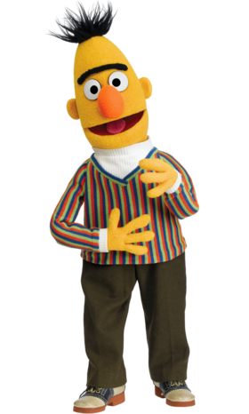
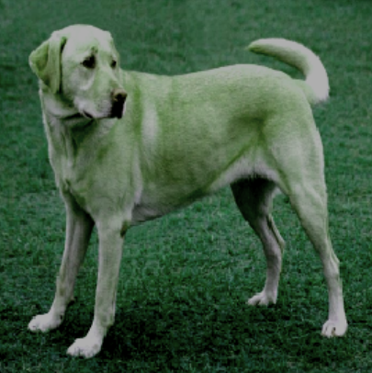
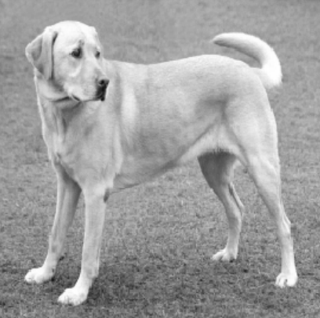
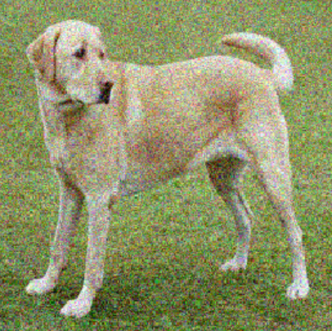
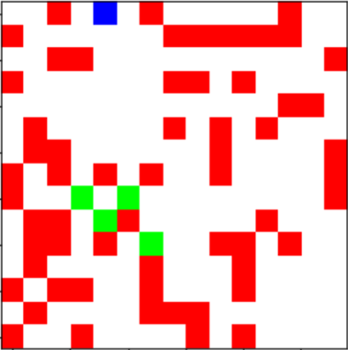
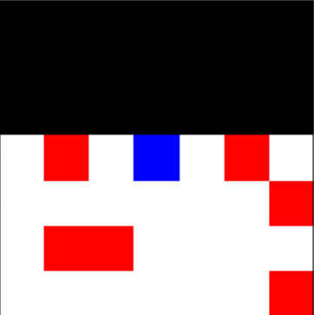
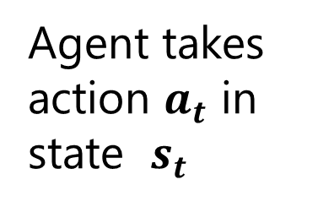
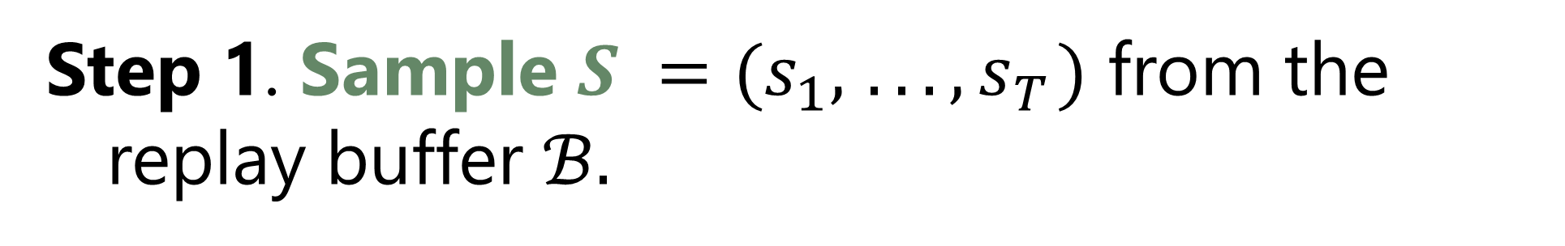
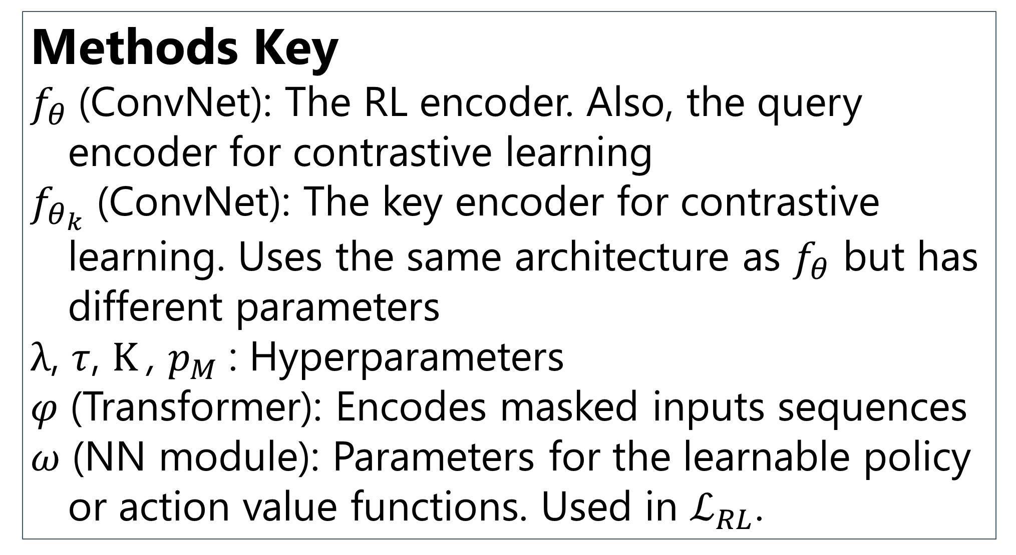
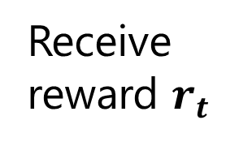
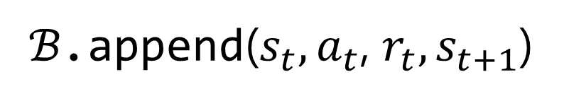
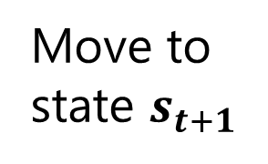


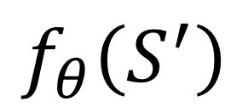

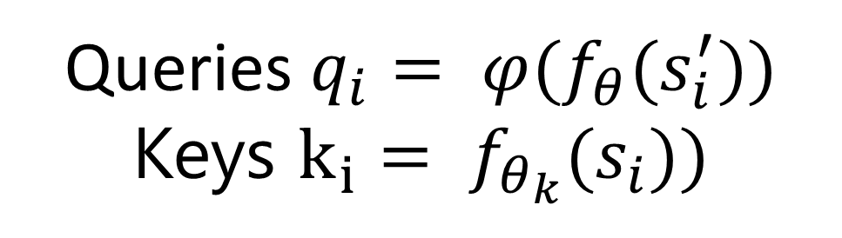
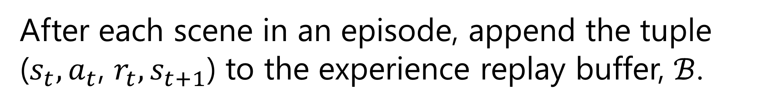
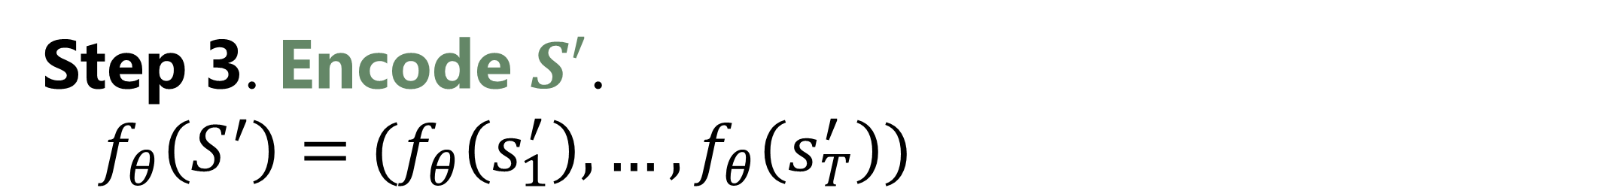
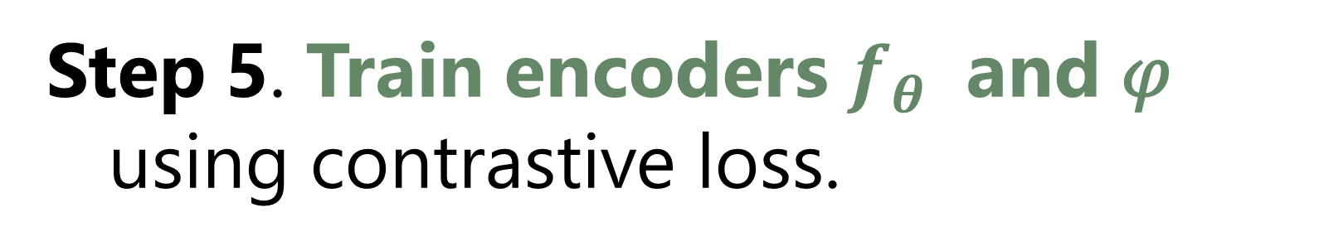
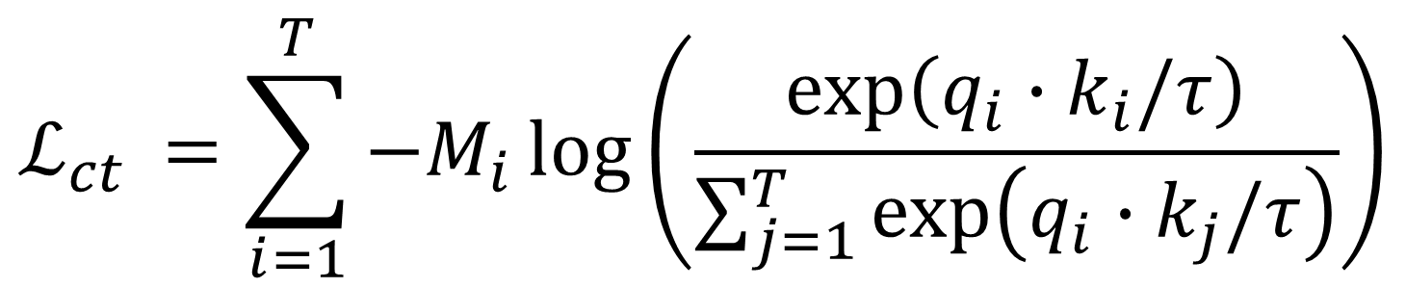
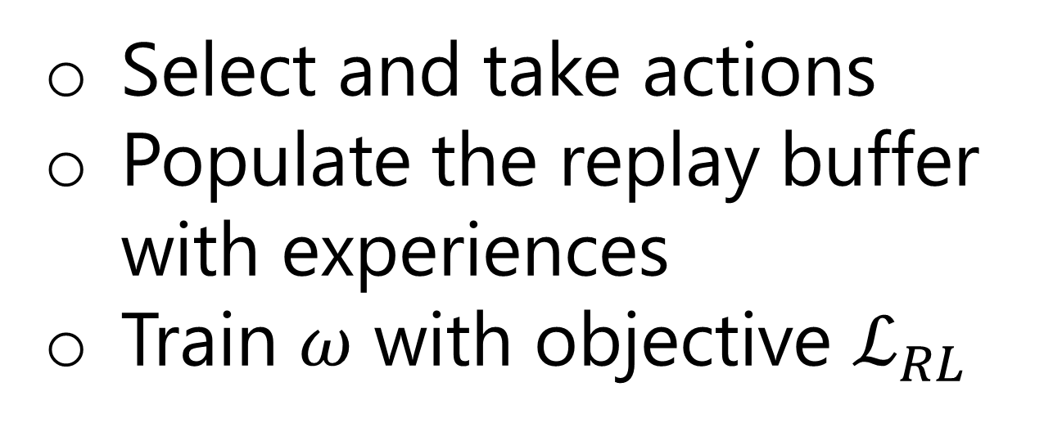
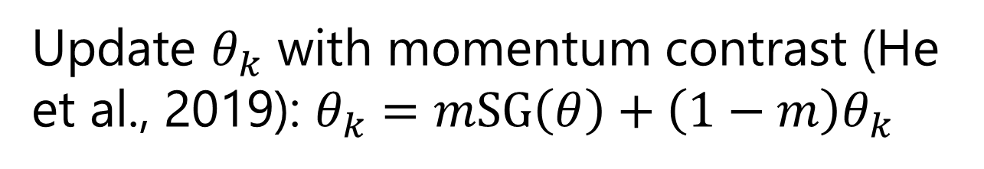
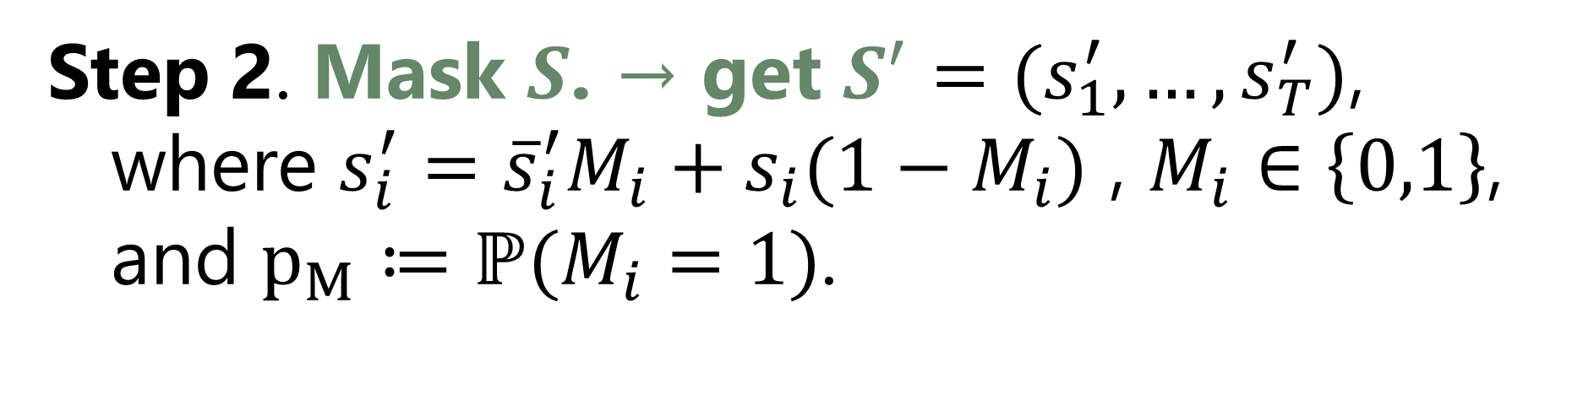
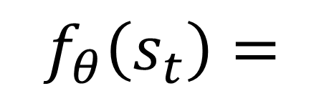
Transformer-Assisted Representation Learning for Deep Reinforcement Learning
Self-Supervised Pre-training (Background)
References
(BERT) Bidirectional Encoder Representations for Transformers
Trained with “masked language model” objective: Mask some percentage of the input sequence and predict the masked elements.
v
Chen et al. (2020). A simple framework for contrastive learning of visual representations. In International conference on machine learning (pp. 1597-1607). PMLR. [pdf]
Devlin et al. (2018). BERT: Pre-training of deep bidirectional transformers for language understanding. arXiv preprint arXiv:1810.04805. [pdf]
Hessel et al. (2018). Rainbow: Combining improvements in deep reinforcement learning. In Proceedings of the AAAI Conference on Artificial Intelligence (Vol. 32, No. 1).
Mnih et al. (2015). Human-level control through deep reinforcement learning. Nature, 518(7540), 529-533. [pdf]
Srinivas et al. (2020). CURL: Contrastive unsupervised representations for reinforcement learning. In International Conference on Machine Learning (pp. 5639-5650). PMLR. [pdf] [code]
Oh et al. (2016). Control of memory, active perception, and action in Minecraft. In International Conference on Machine Learning (pp. 2790-2799). PMLR. [pdf]
Oord et al. (2018). Representation learning with contrastive predictive coding. arXiv preprint arXiv:1807.03748. [pdf]
Zhu et al. (2020). Masked Contrastive Representation Learning for Reinforcement Learning. arXiv preprint arXiv:2010.07470. [pdf] [code]
“You only [mask] once.”
“live”
Contrastive learning:
Self-supervised pre-training method
Effective in computer vision for training image encoders
Encoder: A map from high-dimensional inputs to low-dimensional representations
Allows models with pure pixel inputs to nearly match SOTA performance and sample-efficiency in deep RL (Srinivas et al., 2020)
Goal: Learn a representation space in which different representations of the same image are close together and representations of different images are far apart.
Unique Divine (u.divine@columbia.edu),
Erik Skalnes (eas2301@columbia.edu)
Columbia University
Motivation
Raw sensory inputs often have high dimensionality, making them difficult to work with in the context of reinforcement learning (RL):
Sample-inefficient
Computationally heavy
Auxiliary tasks have been shown to enhance state representations in RL → better performance
Objectives
Improve sample efficiency in sparse-reward, partially observable environments
Train for an unsupervised auxiliary task to efficiently learn better latent representations for image inputs
Perform unsupervised learning and reinforcement learning simultaneously.
Methods
Toy environment:
Masked Contrastive Learning
Overall objective: ${\min_{θ,ω, φ}{\text{ℒ}}{= \text{ℒ}}_{RL}\text{+ }\text{λ}\text{ℒ}}_{ct}$
Step 1. Sample $S =(s_{1},{ .. ., s}_{T})$ from the replay buffer $ℬ.$
Current observation
$$ℬ$$
Reinforcement Learning
Environment
Step 2. Mask $S$. → get $S^{′}=(s_{1}^{′},…,s_{T}^{′})$,
where $s_{i}^{′}={\overline{s}}_{i}^{′}M_{i}+s_{i}(1−M_{i})$ , $M_{i}∈\left\{0,1\right\}$,
and $p_{M}≔ℙ(M_{i}=1)$.
Model-free NN module (parameters 𝜔)
Select and take actions
Populate the replay buffer with experiences
Train 𝜔 with objective $ℒ_{RL}$
$$f_{θ}\left(s_{t}\right)=$$
Step 3. Encode $S^{′}$.
$f_{θ}\left(S^{′}\right)=(f_{θ}\left(s_{1}^{′}\right),…,f_{θ}\left(s_{T}^{′}\right))$
$$ℬ$$
ℬ.append($s_{t},a_{t}$, $r_{t},s_{t+1}$)
Step 4. Reconstruct masked inputs
using the context from the global input.
Methods Key
$f_{θ}$(ConvNet): The RL encoder. Also, the query encoder for contrastive learning
$f_{θ_{k}}$ (ConvNet): The key encoder for contrastive learning. Uses the same architecture as $f_{θ}$ but has different parameters
$\text{λ}$, $τ$, $K$, $p_{M}$: Hyperparameters
𝜑 (Transformer): Encodes masked inputs sequences
𝜔 (NN module): Parameters for the learnable policy or action value functions. Used in ${\text{ℒ}}_{RL}$.
Ongoing & Future Experiments
Benchmark on more challenging environments after tinkering on the toy environment.
Use the transformer to prioritize sequences on the buffer.
Diversify the replay buffer and see if that improves training.
Open-source code coming soon to https://github.com/eskalnes/RL_memory
RL (Background)
Transformer encoder 𝜑
$$f_{θ}\left(S^{′}\right)$$
Environment
Architecture:
Blocks of self-attention followed by fully-connected layer(s)
Residual connections
Layer normalization
Agent takes action $a_{t}$ in state $s_{t}$
Receive reward $r_{t}$
Scene - RL
Move to state $s_{t+1}$
POMDP
Agent
Step 5. Train encoders $f_{θ}$ and 𝜑 using contrastive loss.
$${\text{ℒ}}_{ct }=\sum_{i=1}^{T}{−M_{i}\log\left(\frac{\text{exp}\left(q_{i}∙k_{i}/τ\right)}{\sum_{j=1}^{T}{\text{exp}\left(q_{i}∙k_{j}/τ\right)}}\right)}$$
Queries $q_{i}= {\text{φ}(f}_{θ}(s_{i}^{′}))$
Keys $k_{i}= f_{θ_{k}}(s_{i}))$
After each scene in an episode, append the tuple ($s_{t},a_{t}$, $r_{t},s_{t+1}$) to the experience replay buffer, $ℬ$.
Update $θ_{k}$ with momentum contrast (He et al., 2019): $θ_{k}=m\text{SG}\left(θ\right)+\left(1−m\right)θ_{k}$

